Slide 1
WELCOME

Slide 2
Telemetric versatile accident detection, tracking and security ; Messaging system(TelVerADeTeS-MessaSys)
Crew:
Abel C Dixon
Jeswin E K

Slide 3
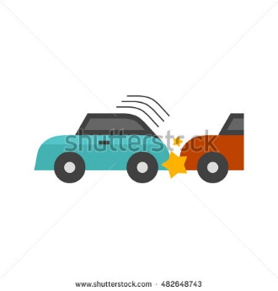




2)Tracking :-
1)Accident Detection :-
Motor Vehicle Accident Detection Messaging Unit
RF Transmitter and Receiver(315MHz)
Piezo-Electric Disc
Gas Leakage Detection Messaging Unit
MQ6 Gas Sensor
Commanded and Live Vehicle Tracking Unit
Ocean Airline Disaster Plane Tracking Unit
3)Security :-
Hi-Tech Double Bond Theft Security Unit

Slide 4
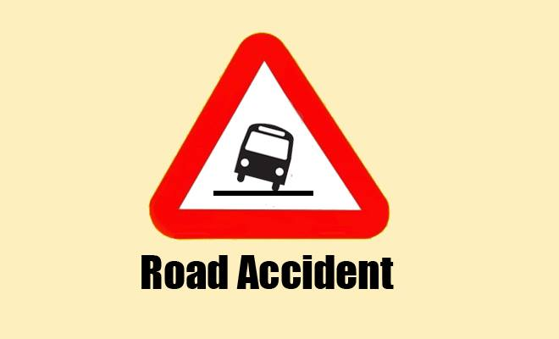

Slide 5


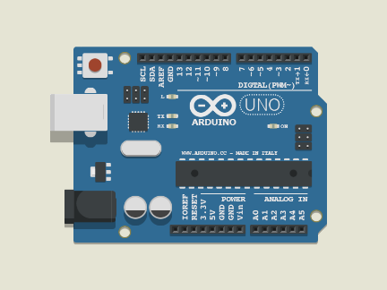
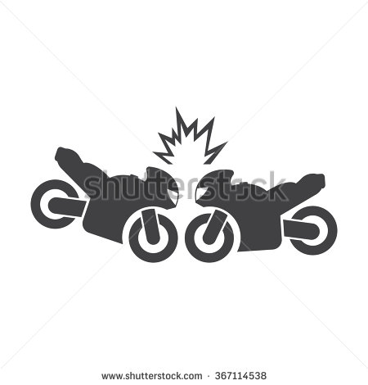


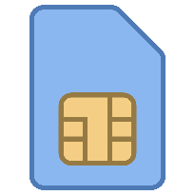
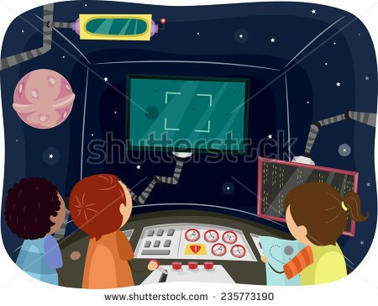
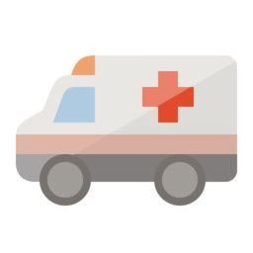
GPS
Arduino
Detection
Tranmitter
Reciever
GSM
Friend and Relatives
Control Room
Ambulance

Slide 6
With live Server updations !
TeleVerADeTes has been intelligently designed to log Accident Informations Live on WEB .It is designed to connect to server and store the information in our DATABASE architecture.Database provides a consistency in displaying up informations without interuptions.
Thu

Slide 7
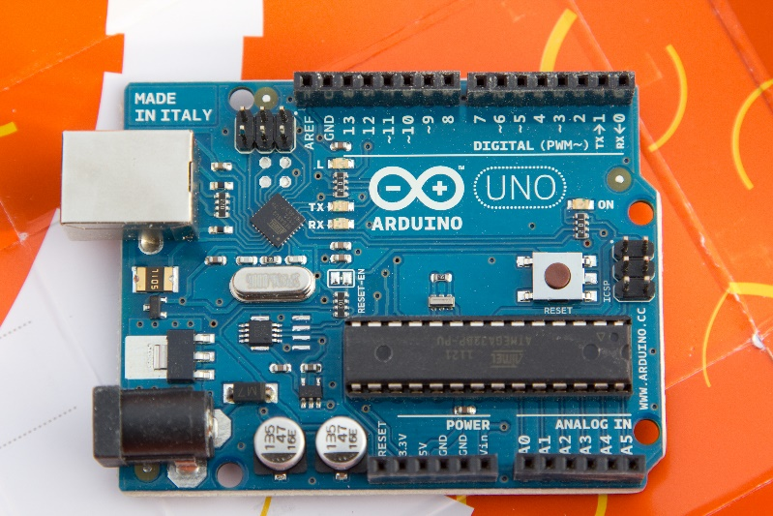
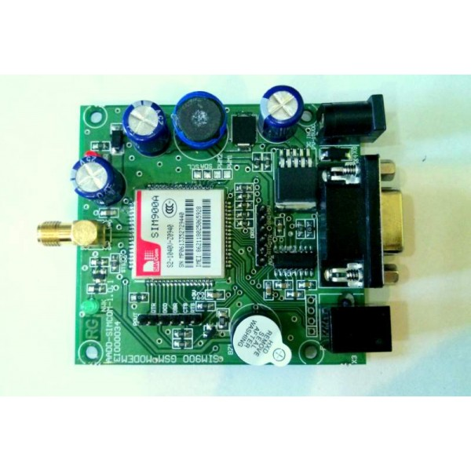
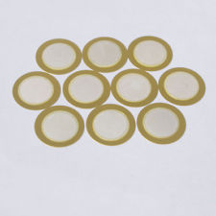
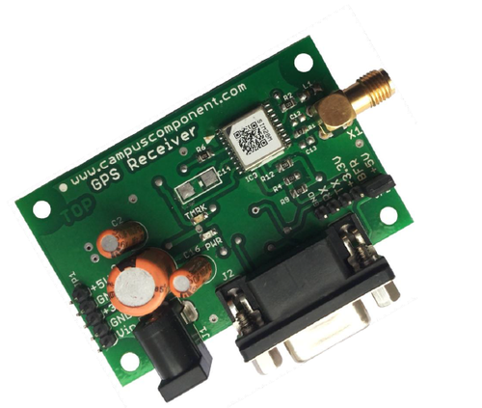
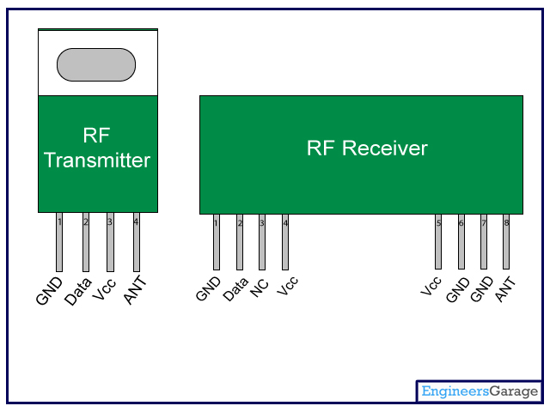
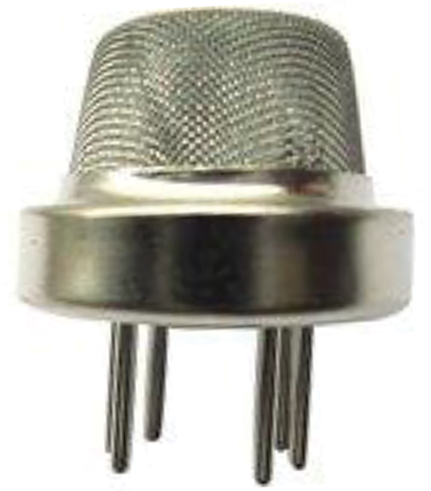
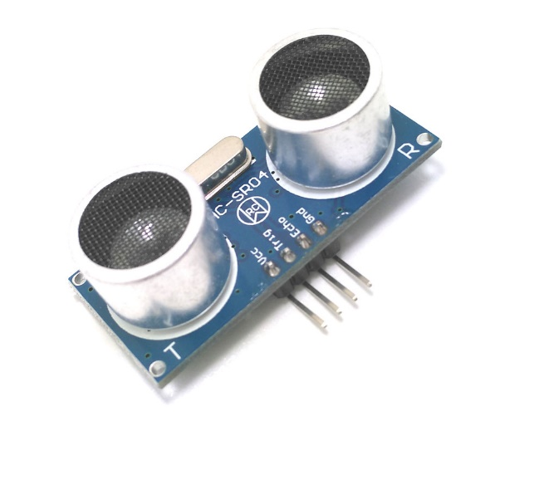
Arduino UNO R3
GSM Module
Piezo Disc
GPS Module
RF Transmitter
MQ6 Gas Sensor
Ultrasonic Module

Slide 8
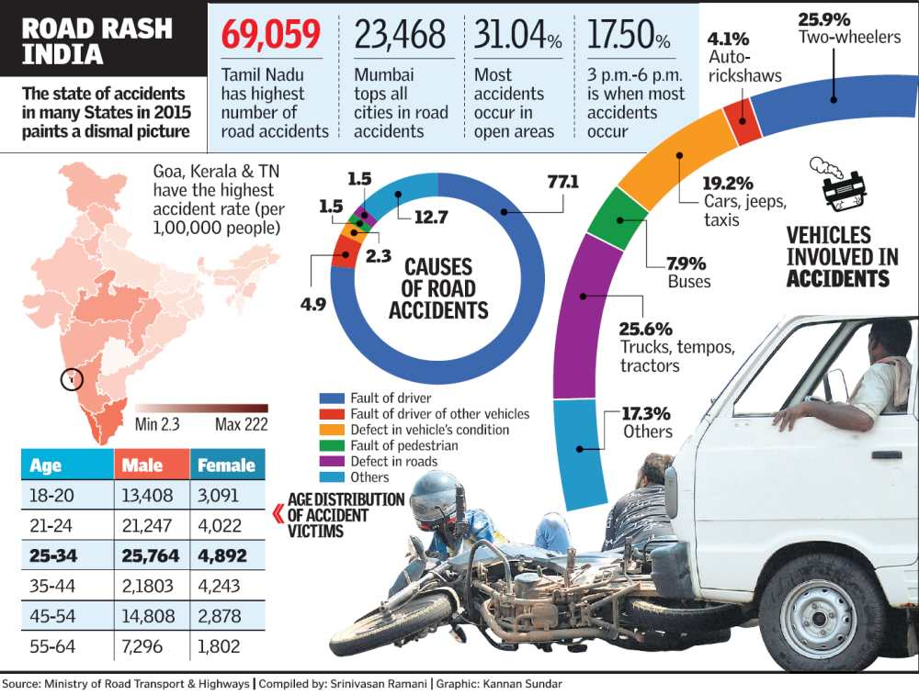

Slide 9
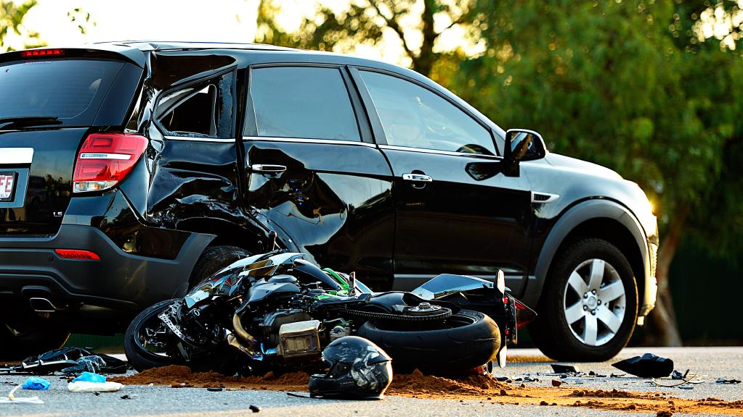
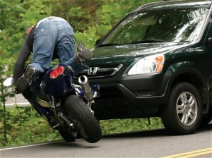
After All , Why did we Innovated this ?

Slide 10
Tracking And Theft Security System
TelVerADeTeS-MessaSys Comes with a Whole new features to secure your Vehicle
You can Track Your Vehicle With the following commands
Track<space>Your Vehicle registration.No+4 digit pin number
You will receive an instant Message from TelVerADeTeS-MessaSys
When Talking About Security From Thieves
TelVerADeTeS-MessaSys Comes with Double Bond Security System That Secure Your Vehicle 24x7 Hours.
Instantaneous 8s Message Burst and 30s Burst , Help You Live Track Your Vehicle .

Slide 11
How This Will Help Our Community ?
Compel People To Wear Helmets
35% of Life Can Be Saved
People Will Be Aware Of Road Safety
Better Road Safety Rules Will Be Out
Development Of Our Country
Inspiration To Future

Slide 12
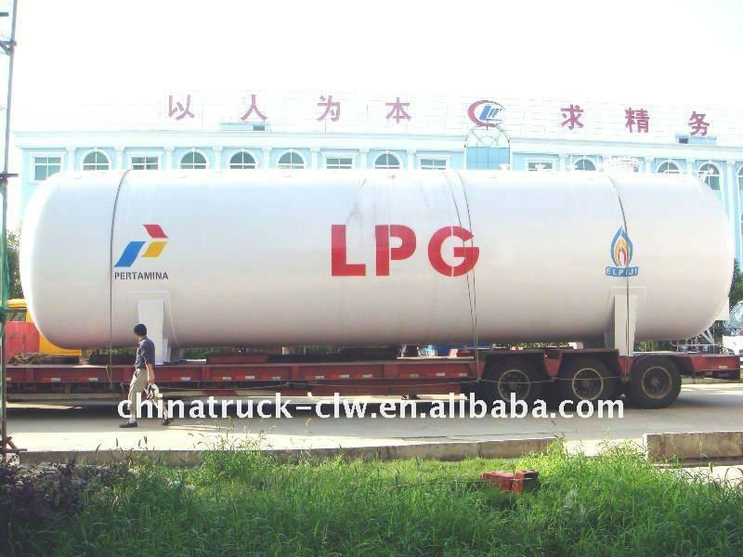
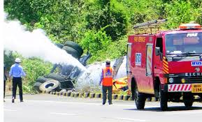
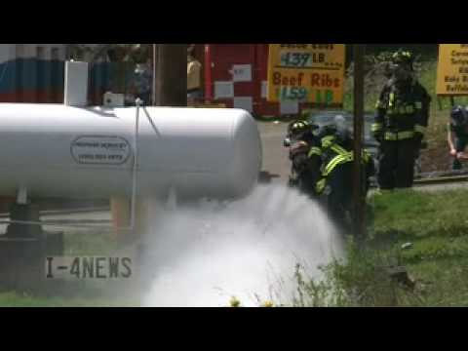
What if this happens so early????

Slide 13
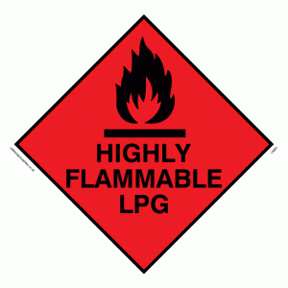
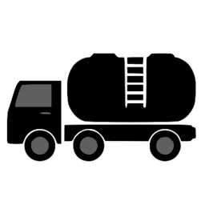
Gas Leakage Detection Messaging Unit

Slide 14
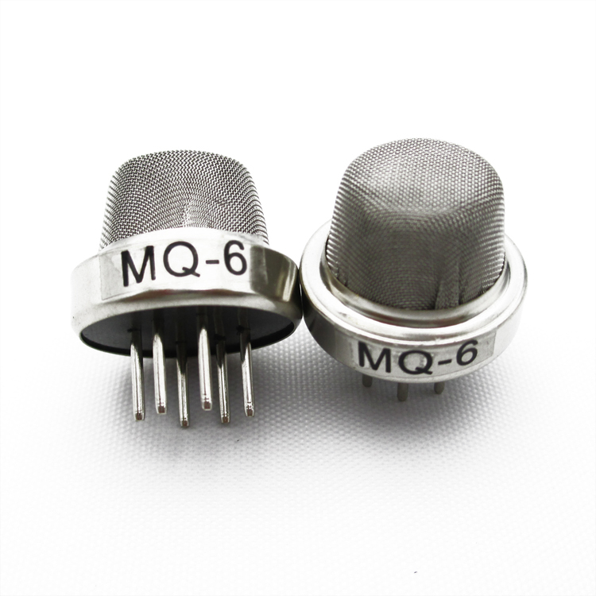
About MQ6
This is a simple-to-use liquefied petroleum gas (LPG)sensor, suitable for sensing LPG (composed of mostly propane and butane) concentrations in the air. The MQ-6 can detect gas concentrations anywhere from 200 to 10000ppm.
This sensor has a high sensitivity and fast response time. The sensor’s output is an analog resistance.

Slide 15


What change can ?
Safety and Security
Ideal Alarm System
Major Deaths Can Be Avoided
Firefighter Can Take Respective Actions
People Will Be Alerted
People Can Move More Secure Places
Electricity Board Can Power of Electric Lines

Slide 16

Ocean air craft disaster tracking system
Alternate way to Sound Navigation and Ranging System
During the crash floating components are ejected from the Aircraft
Black Box emit ultra sonic sound(37.5KHz) which communicate with our system to trigger the messaging activity
In order to reduce the interruption caused due to the travel of radio waves through the saline water pico cell, or micro cell or signal boosters.
Even if networks are not available our system communicate with

Slide 17
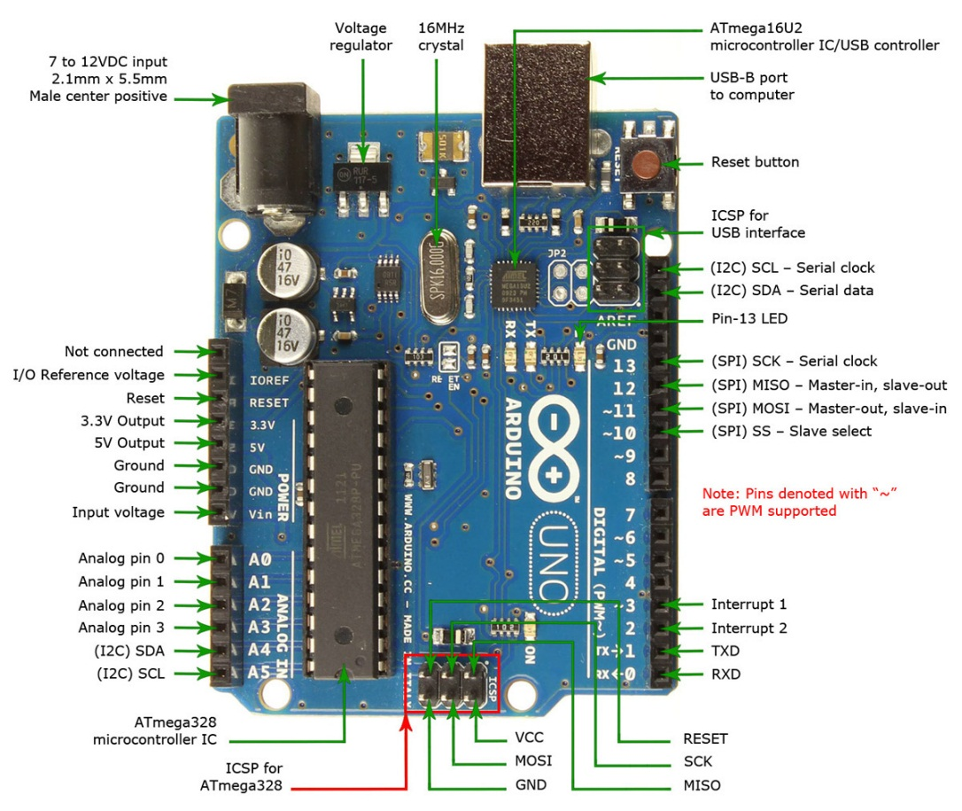
Arduino UNO R3
Arduino is an open-source computer hardware and software company, project and user community that designs and manufactures microcontroller-based kits for building digital devices and interactive objects that can sense and control objects in the physical world.
Arduino Uno uses embedded C/C++ programming language.Program in Arduino are called Sketches
“Arduino Uno R3 board used in our is smart and intelligent to take decision on scenarios necessarily. ”

Slide 18
GSM Module(Global System for Mobile Communications)
A GSM modem is a specialized type of modem which accepts a SIM card, and operates over a subscription to a mobile operator, just like a mobile phone.
GSM module in sync with Arduino , shares its informations to Arduino and Arduino finally transmits final results to the GSM Module and Broad casts the SMS (Short Message Service) to the Control Room and with Friends and Relatives

Slide 19
GPS Module(Global Positioning System)
The Global Positioning System (GPS) is a global navigation satellite system (GNSS) made up of a network of a minimum of 24, but currently 30, satellites placed into orbit by the U.S. Department of Defense.
A minimum of four satellites are necessary to retrieve the latitude ,longitude and time.
“Our GPS module retrives Latitude and Longitude and share those informations to Arduino”

Slide 20
Accident Brings Tears;
Safety Brings Cheers

Slide 21
https://github.com/CasCard/Arduino/blob/master/accident_security.ino
For Source Code(Arduino) Visit :

